Slide 1

The behaviors of eigenvalues and eigenvectors
Jason Mejia
5/10/2021
CSC 301

Slide 2

Objective
What are eigenvalues and eigenvectors?
Why they are important?
What do they tell us?

Slide 3
What are eigenvalues and eigenvectors?
Eigenvalues: special set of scalars associated with the system of linear equations. It is mostly used in matrix equations. If we let A be an n×n matrix. An eigenvalue of A is a scalar λ such that the equation Av=λv.
Eigenvector: are the vectors (non-zero) that do not change the direction when any linear transformation is applied. It changes by only a scalar factor. If we let A be an n×n matrix. An eigenvector of A is a nonzero vector v in Rn such that Av=λv, for some scalar λ.
Why are eigenvalues and eigenvectors important?
Eigenvectors make understanding linear transformations easy. They are the "axes" (directions) along which a linear transformation acts simply by "stretching/compressing" and/or "flipping"; eigenvalues give you the factors by which this compression occurs.
Eigenvalues can be used to determine whether a fixed point (also known as an equilibrium point) is stable or unstable. A stable fixed point is such that a system can be initially disturbed around its fixed point yet eventually return to its original location and remain there

Slide 4
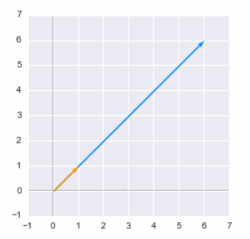

Using eigenvalues and eigenvectors for transformations
Simple view of eigenvalue and a eigenvector.
A = $\left[\begin{matrix}5 & 1 \\ 3 & 3\end{matrix}\right]$ Eigenvalue = $\begin{matrix}6 & 6\end{matrix}$ Eigenvector = $\begin{matrix}1 \\ 1\end{matrix}$

Slide 5
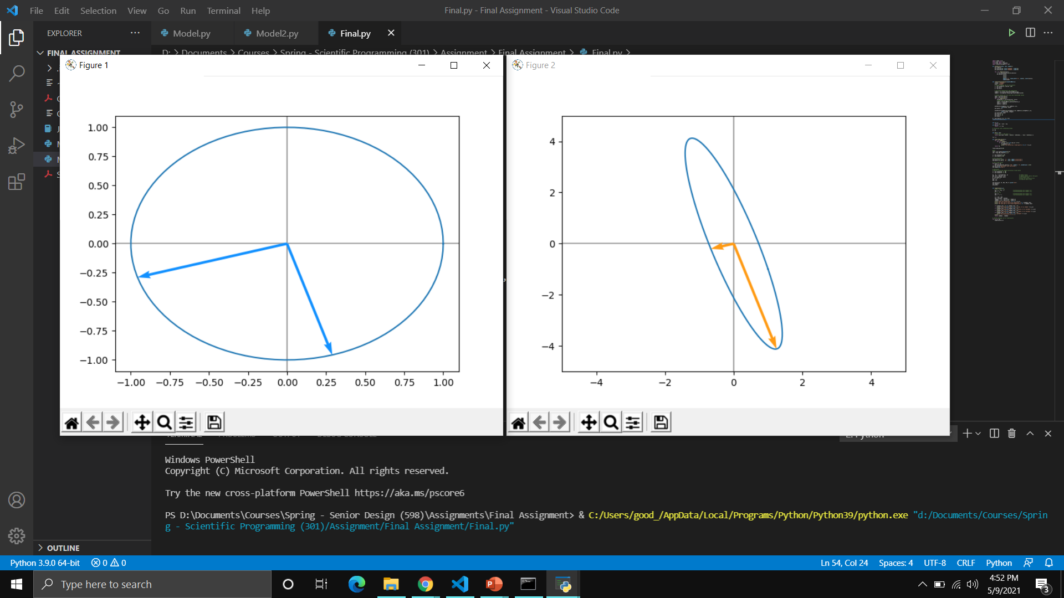

Using eigenvalues and eigenvectors for transformations
We will transform each of these points by applying a matrix A to a unit circle.
A = $\left[\begin{matrix}1 & −1 \\ −1 & 4\end{matrix}\right]$ Eigenvalue = $\begin{matrix}0.69722 & 4.3027\end{matrix}$ Eigenvector = $\begin{matrix}−0.9570 & 0.2897 \\ −0.2897 & −0.9570\end{matrix}$

Slide 6
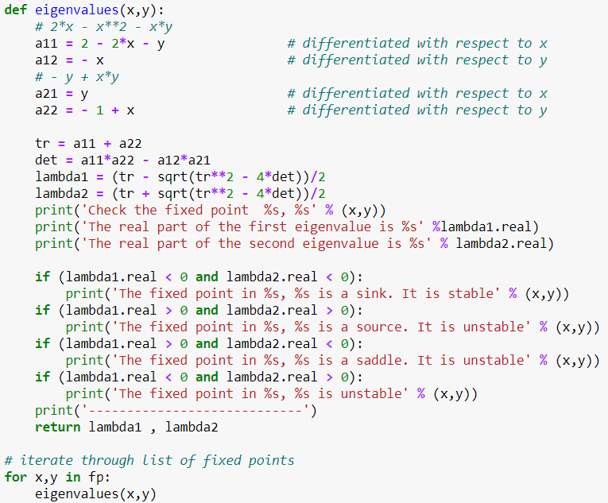
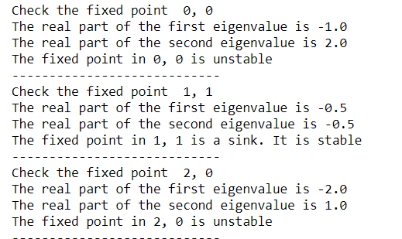
Calculating Eigenvalues and Eigenvectors from a Jacobian Matrix
2x – x² – xy
-y + xy

Slide 7
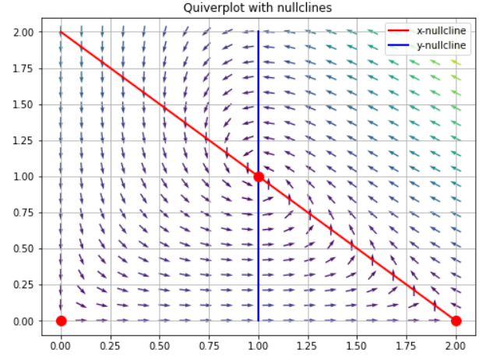
Calculating Eigenvalues and Eigenvectors from a Jacobian Matrix
2x – x² – xy
-y + xy
When the real part is negative, then the system is stable and behaves as a damped oscillator. This can be visualized as a vector tracing a spiral toward the fixed point in the graph.

Slide 8
Conclusion
Eigenvalues and Eigenvectors helps us understand and visualize linear transformations. This is useful when it involves computer graphics.
They will tell us information on stability, whether a point is unstable or stable
There are many more applications that eigenvalues and eigenvectors can be used on such as
Image Processing
Google Searches
Vibration Analysis

